Slide 1
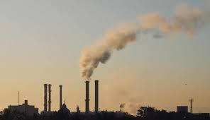
Project 4 The correlation between lung cancer and air pollution
Created By Travis Jones

Slide 2


In this presentation we’ll be looking at what the environmental causes that could lead to lung cancer.
The air pollutants
Environmental quality index
Particulate matter
Visual info
Prediction models
Conclusion

Slide 3
Air Pollutants
SO2: Sulfur dioxide is produced from burning fossil fuels, it can be a threat to human, animal, and plant life.
NO2: Nitrogen dioxide is produced from burning fossil fuels, it can affect the lungs in a number of different ways.
O3: Ozone comes from cars, powerplants, industrial boilers, refineries, and chemical plants, it can cause difficulty breathing and other health issues
CO: Carbon Monoxide is produced from fossil-fueled engines, carbon monoxide can reduce the oxygen delivery to the body leading to numerus health issues.
CN: Cyanide is naturally present in water but at very low concentrations, the is large enough can have grave effects of the human body.
Diesel: The burning of diesel fuel can add several air pollutants and pm (particulate matter) into the air.
CS2: Carbon disulfide is a natural gas released in nature. At very high levels it can have threatening effects on the nervous system.

Slide 4
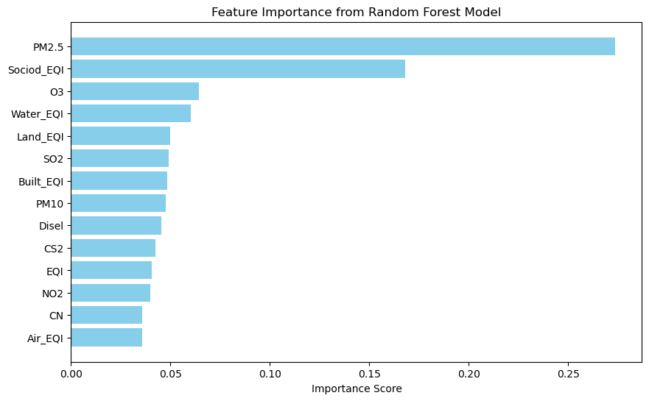
Most impactful pollutants

Slide 5

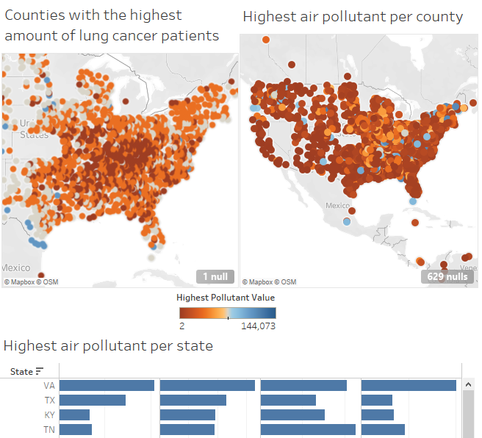
Counties with highest amount of lung cancer patients versus counties with the highest air pollution

Slide 6
EQI Environmental quality index
Environmental quality index looks at the effect different environmental variables can have on individuals' health, from the air we breathe, the water we drink, the ground we stand on, to the very building we live in, even to our sociodemographic.
PM Particulate Matter
Particulate Matter isn’t a single pollutant but is a mixture of many chemical species of varies sizes.
PM2.5: Is derived from burning different materials such as gasoline, oil, and wood.
PM10: Is derived from the same materials as PM2.5 but also includes larger particles such dust from construction, landfills and several other sources.

Slide 7
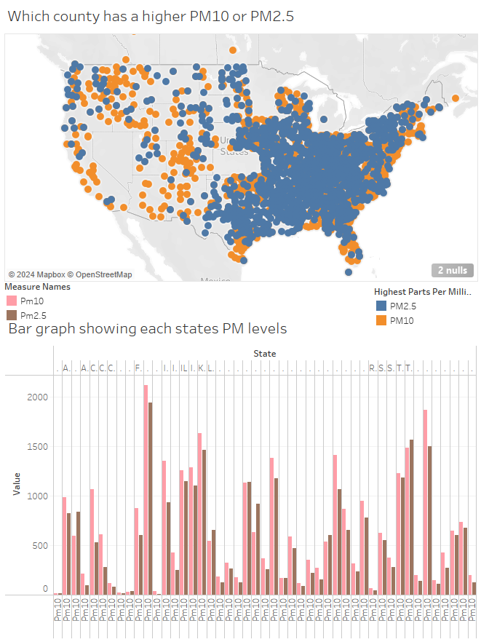
Highest Particulate Matter per county

Slide 8
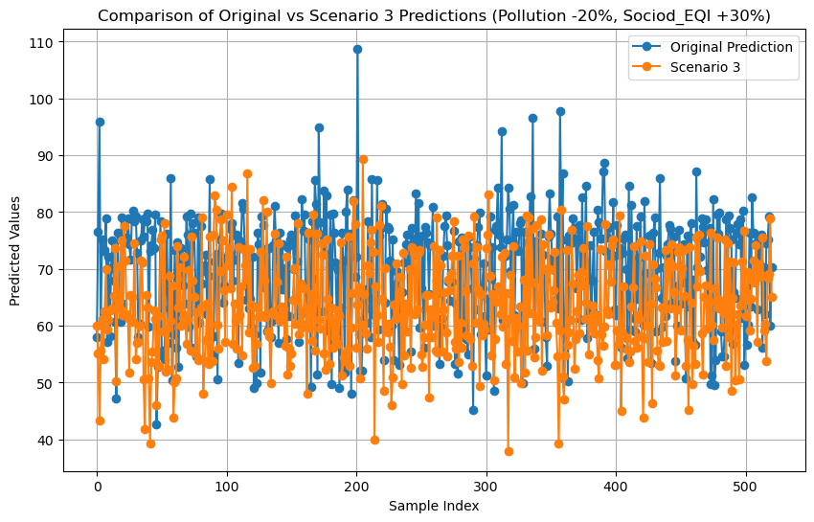
Pollution -20%, Sociodemographic EQI +30%
In this graph we can see a slight reduction in lung cancer severity by simple improving the living standards by 30% and lowering emissions by 20%.

Slide 9
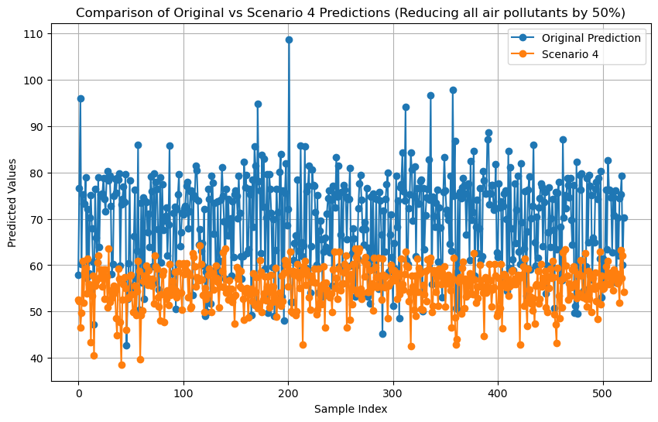
Reducing all air pollutants by 50%
In this graph it show a huge reduction in lung cancer severity by reducing air pollution by 50%

Slide 10
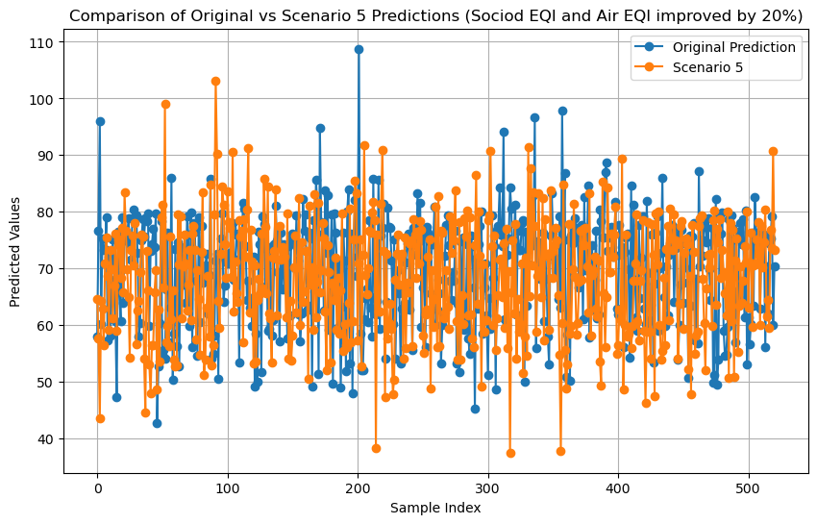
Sociodemographic EQI and Air EQI improved by 20%
This graph show a slight improvement in lung cancer severity by improving peoples sociodemographic and improving the air quality.

Slide 11
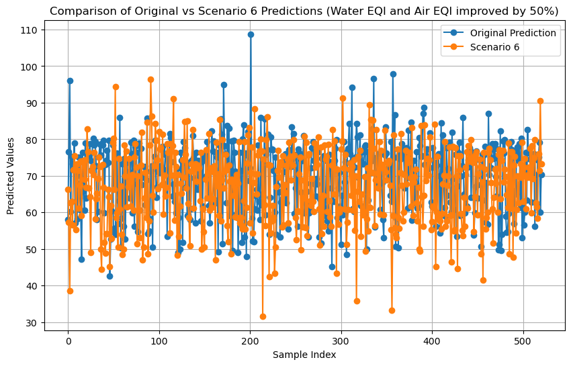
Water EQI and Air EQI improved by 50%
In this graph we can see a slight improvement to lung cancer due to improving the air and water quality.

Slide 12
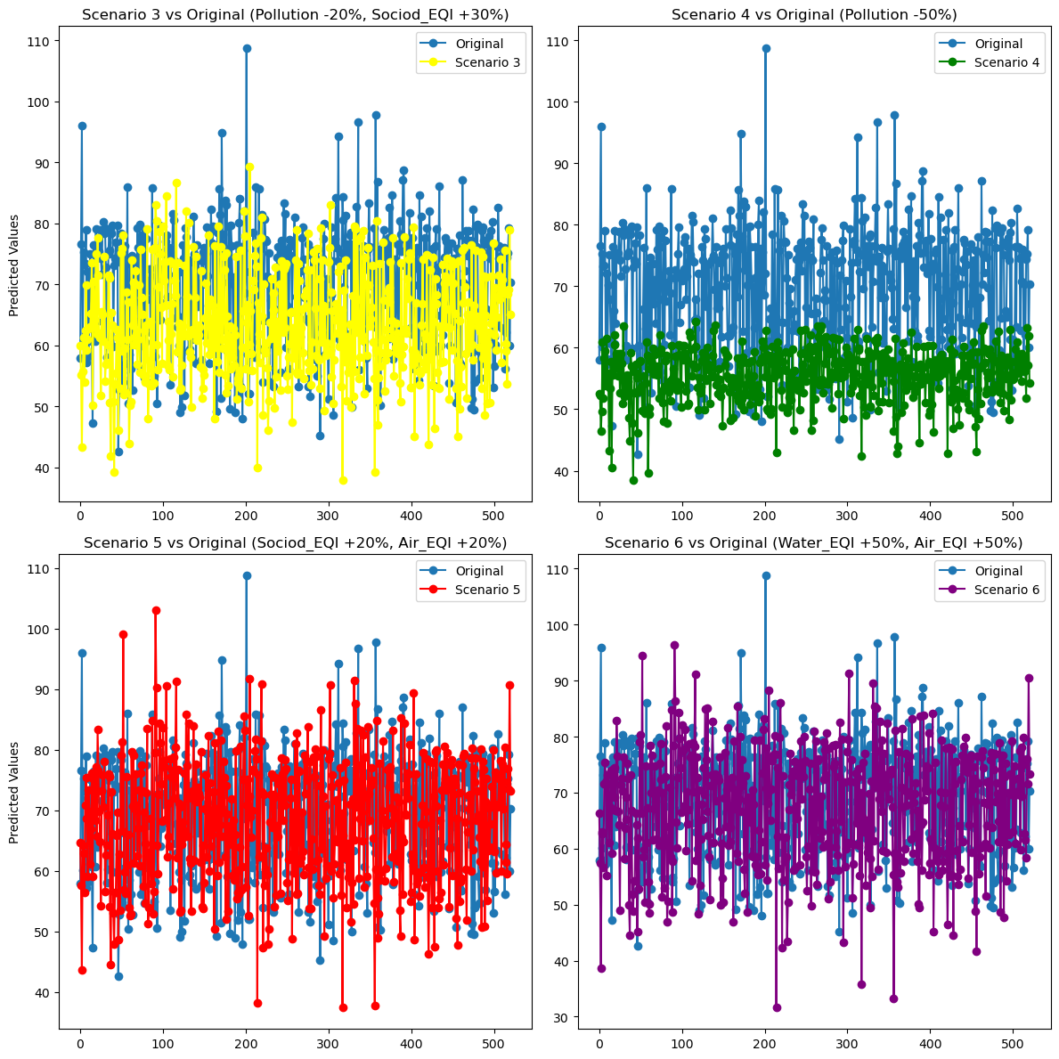
A comparison between all graphs

Slide 13
Conclusion
By looking at where the pollution is the worse and by improving emission rate and quality of living by small margins the over all severity of lung cancer can be reduced greatly.

